Slide 1
HiVOTER VOLUNTEER Election Day Official Volunteer Portal
State of Hawaii
Office of Elections
Notes:
RR: Greet and Introduce. We are excited to be apart of this year’s Code Challenge.
AT: Thank. We are here today seeking your coding-minds and expertise to improve the voter experience.

Slide 2
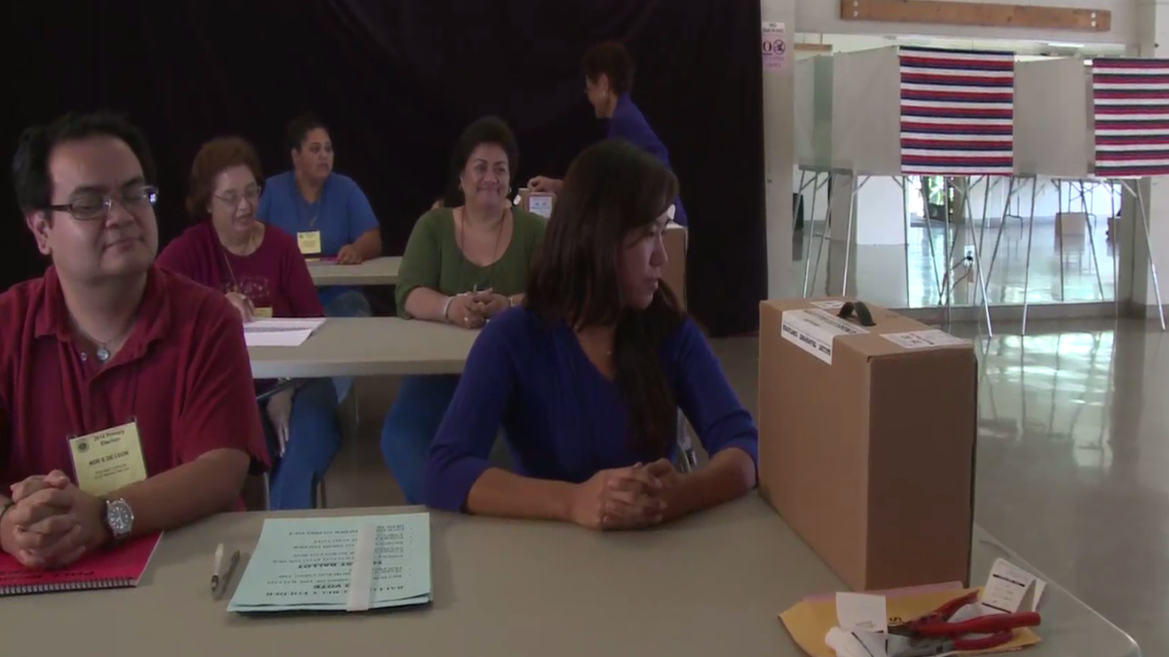
VOLUNTEER
4,000
Notes:
RR: One of the challenges that affects the voter experience is a fully staffed polling place and recruiting Election Day Officials. We depend on more than 4,000 volunteers. Volunteers work at over 200 polling places, 4 counting centers, 4 control centers, and hundreds of delivery/collection routes, statewide.
AT: We need your help to find a solution to streamline volunteer sign-ups and scheduling trainings. Every year it gets more difficult and time consuming to connect with volunteers. Let’s show them what a call is like.

Slide 3


Let’s Schedule Training
Notes:
AT: [OE Staff]
RR: [Volunteer]

Slide 4
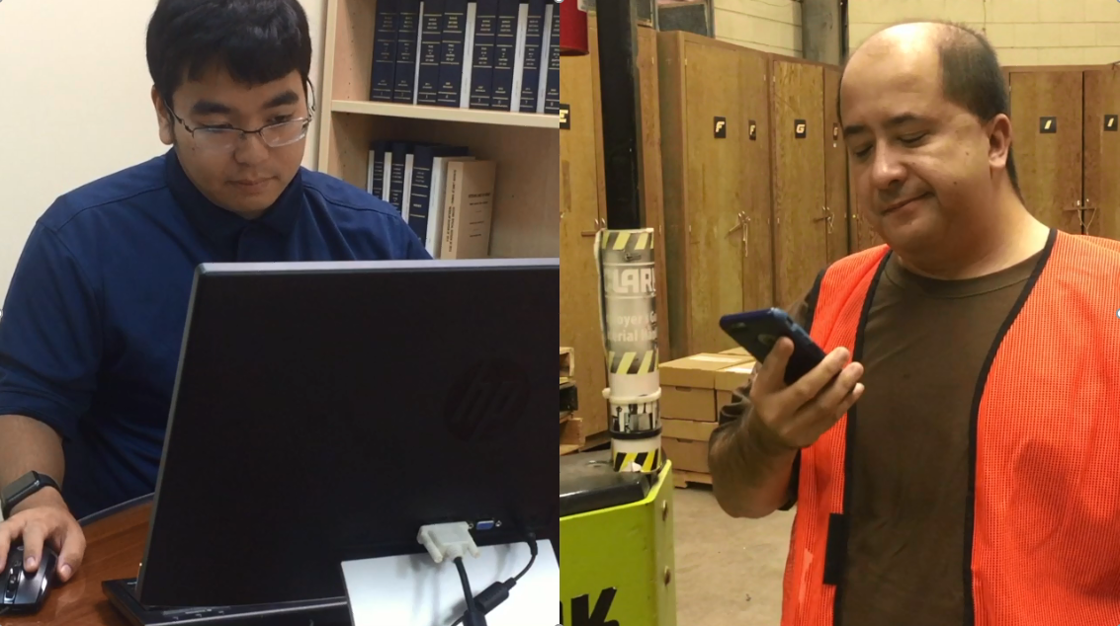
CHALLENGE
Notes:
RR: I’m not calling you back. If I remember to call, you’ll probably out of the office at a training or something. Is that a typical call?
AT: It happens more than we’d like. Phone tag is the worst. It makes it hard to connect with each volunteer.

Slide 5



WHAT WE NEED
Online Recruitment
Schedule Training
Email
Reminders
Notes:
AT: We need a quick, convenient way for volunteers to sign-up, schedule training, and receive reminders. Because volunteers are essential to the conduct of the elections.
RR: That’s right. A fully staffed polling place means a smooth voting experience. If it is easy, everyone will do it.

Slide 6
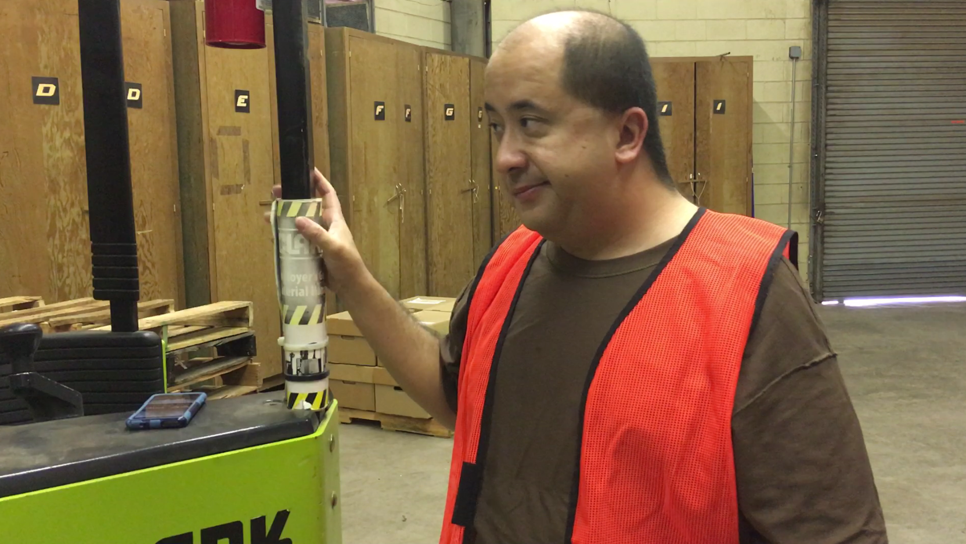
DON’T GIVE UP
Notes:
AT: That’s why we need the HACC. Help us, help you on Election Day. Don’t be like this guy. Call us back.

